Slide 1
Paper Sharing
赵若情 2021.12.06

Slide 2
Datasets
OPEN I
MIMIC-CXR
ChestX-ray14
IU X-ray

Slide 3
TieNet: Text-Image Embedding Network for Common Thorax Disease Classification and Reporting in Chest X-Rays
TieNet：胸部X光常见疾病分类报告的文本-图片嵌入网络
Xiaosong WangYifan PengLe LuZhiyong LuRonald M. Summers
Computer Vision and Pattern Recognition Jun 2018

Slide 4
Introduction
In the last decade, challenging tasks in computer vision have gone through different stages, from sole image classification to multi-category multi-instance classification/detection/segmentation to more complex cognitive tasks that involve understanding and describing the relationships of object instances inside the images or videos.
There are few publicly available large-scale image datasets in the medical image domain. Conventional means of annotating natural images cannot be applied to medical images due to the fact that these tasks often require years of professional training and domain knowledge.
Different from current deep learning models, radiologists routinely observe multiple findings when they read medical images and compile radiological reports. One main reason is that these findings are often correlated.
For instance, liver metastases can spread to regional lymph nodes or other body parts.
This paper, they investigate how free-text radiological reports can be exploited as a priori knowledge using an innovative text-image embedding network.

Slide 5
Related work
Wang et al. [35] provide a recent and prominent exception, where they introduced a large scale chest X-ray dataset by processing images and their paired radiological reports (extracted from their institutional PACS database) with natural language processing (NLP) techniques. radiological reports contain richer information than simple disease binary labels.
We differ from Wang et al.’s approach by leveraging this rich text information in order to produce an enhanced system for chest X-ray CADx.
More recently, multi-attention models [38, 27] extract salient regions and words from both image and text and then combine them together for better representations of the pair. In medical imaging domain, Shin et al.[32] proposed to correlate the entire image or saliency regions with MeSH terms.
The difference between our model and theirs lies in that we employ multi-attention models with a mixture of image and text features in order to provide more salient and meaningful embeddings for the image classification and report generation task.
The attention mechanism attempts to ease the problems which is that the input is long or very information-rich and selective encoding is not possible,by allowing the decoder to refer back to the input sequence [39, 23, 25]. To this end, our work closely follows the one used in [23] where they extracted an interpretable sentence embedding by introducing self-attention. Our model paired both the attention-based image and text representation from training as a prior knowledge injection to produce improved classification scores.

Slide 6
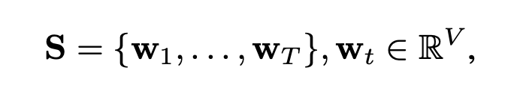
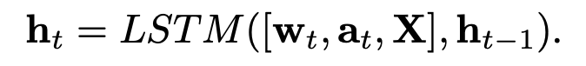
Model
Text-Image Embedding Network
End-to-End Trainable CNN-RNN Model
Our end-to-end trainable CNN- RNN model takes an image I and a sequence of 1-of-V encoded words.
Our RNN is based off of Xu et al.’s visual image spatial attention model [37] for image captioning. However, following Xu et al. [37], our sequence-to-sequence model includes a deterministic and soft visual spatial attention, a_{t}, that is multiplied element-wise to X before the latter is inputted to the RNN. At each time step, the RNN also outputs the subsequent attention map, at+1.
The LSTM produces the report by generating one word at each time step conditioned on a context vector, i.e., the previous hidden state h_{t}, the previously generated words w_{t}, and the convolutional features of X whose dimension is D × D × C. Here D = 16 and C = 1024 denote the spatial and channel dimensions, respectively. Once the model is trained, reports for a new image can be generated by sequentially sampling w_{t} ∼ p(w_{t} | h_{t} ) and updating the state using Equation.

Slide 8
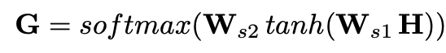
Attention Encoded Text Embedding
we use attention to combine the most salient portions of the RNN hidden states.
With the attention calculated, we compute an r × d_{h} embedding matrix, M = GH, which in essence executes r weighted sums across the T hidden states, aggregating them together into r representations.
Each row of G, denoted g^{i} (i ∈ {1 . . . r}), indicates how much each hidden state contributes to the final embedded representation of M.
To provide a final global text embedding of the sentences in the report, the AETE executes max-over-r pooling across M, producing an embedding vector X^{ˆ} _{AETE} with size d_{h}.

Slide 9
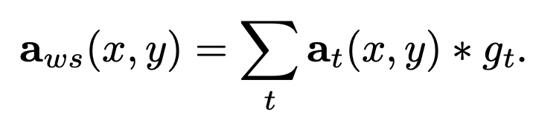
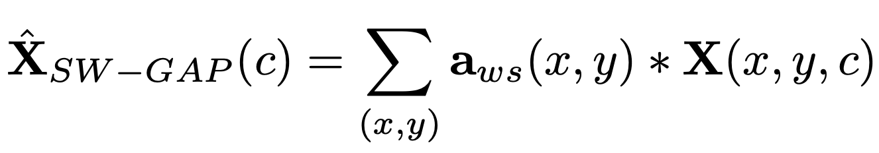
Saliency Weighted Global Average Pooling
In addition to using attention to provide a more meaningful text embedding, our goal is also to produce improved visual embeddings for classification.
we re-use the attention mechanism, G, except that we perform a max-over-r operation, producing a sequence of saliency values, g_{t}(t = 1, . . . , T ), for each word, w_{t}. These saliency values are used to weight and select the spatial attention maps, at, generated at each time point:
This map is encoded with all spatial saliency regions guided by the text attention. We use this this map to highlight the spatial regions of X with more meaningful information:
where x, y ∈ {1...D} and X^{ˆ} _{SW −GAP} is a 1-by-C vector representing the global visual information, guided by both text- and visual-based attention.

Slide 10
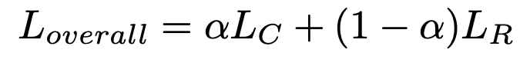
Joint Learning
we concatenate the two forms of representations X^{ˆ} = [X^{ˆ} _{AETE} ; X^{ˆ} _{SW −GAP} ] and use a final fully-connected layer to produce the output for multi-label classification.
Here, we adopt the NLP-mined labels provided by [35] as the ‘ground-truth’ during the training.
the overall loss is composed of two parts, the sigmoid cross entropy loss LC for the multi-label classification and the loss LR from the RNN generative model
Medical Image Auto-Annotation
Automatic Classification and Reporting of Tho- rax Diseases

Slide 11
Experiments
Datasets
-ChestX-ray14
-Hand-labeled
-OpenI
Report vocabulary
-We use all 15,472 unique words in the training set that appear at least twice.
Evaluation Metrics
-To compare previous state-of-the- art works, we choose different evaluation metrics for differ- ent tasks so as to maintain consistency with data as reported in the previous works.
Training
-The LSTM model contains a 256 dimensional cell and s = 2000 in Ws1 and Ws2 for generating the attention weights G. During training, we use 0.5 dropout on the MLP and 0.0001 for L2 regularization. We use the Adam optimizer with a mini-batch size of 32 and a constant learning rate of 0.001.
-In addition, our self-attention LSTM has a hidden layer with 350 units. We choose the matrix embedding to have 5 rows (the r), and a coefficient of 1 for the penalization term. All the models are trained until convergence is achieved and the hyper-parameters for testing is selected according to the corresponding best validation set performance.

Slide 12
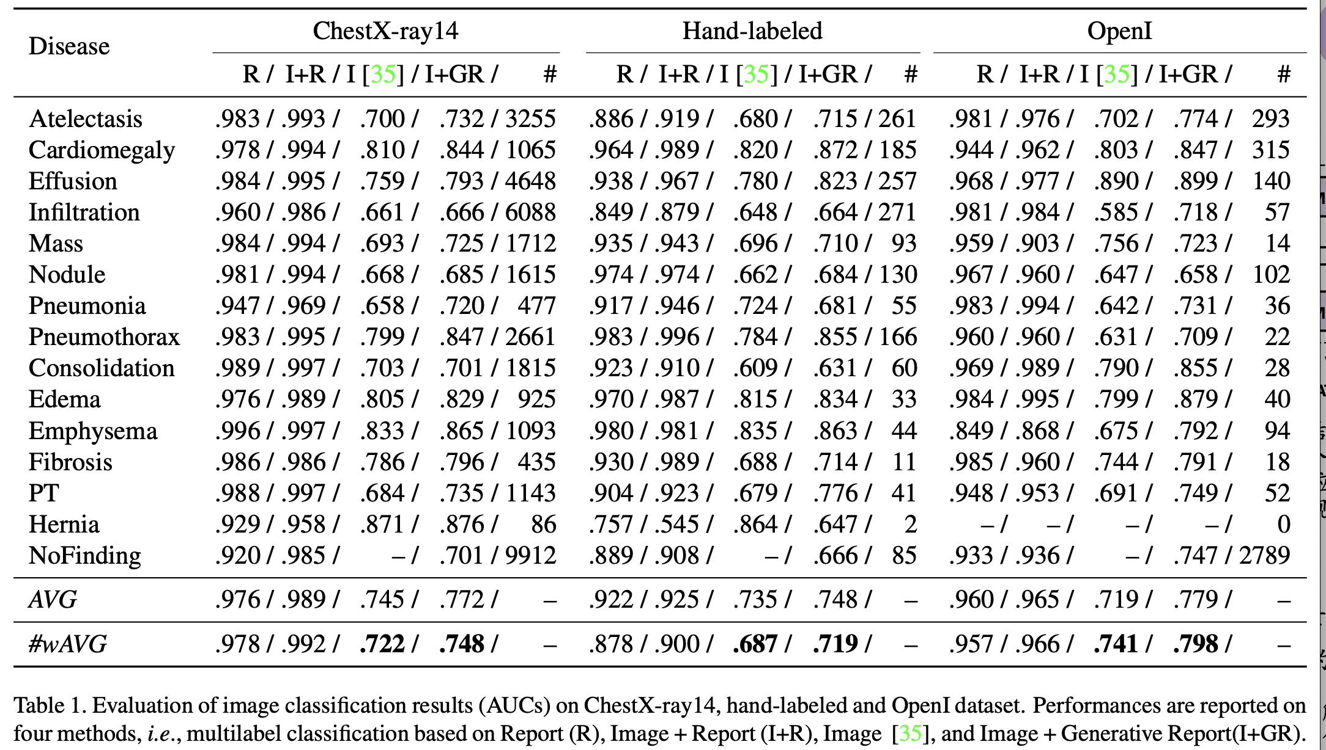

Slide 13
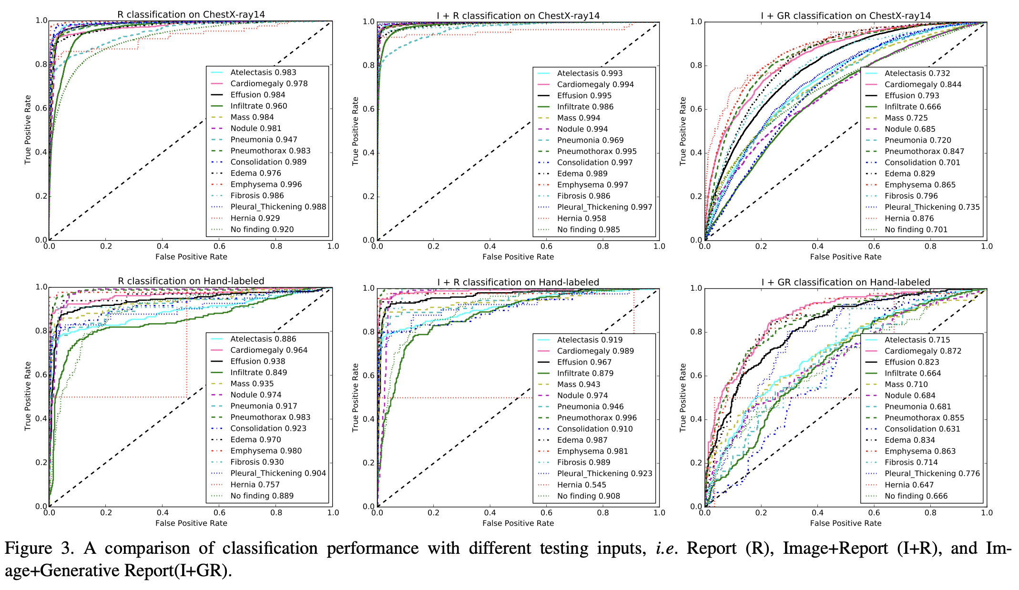

Slide 14
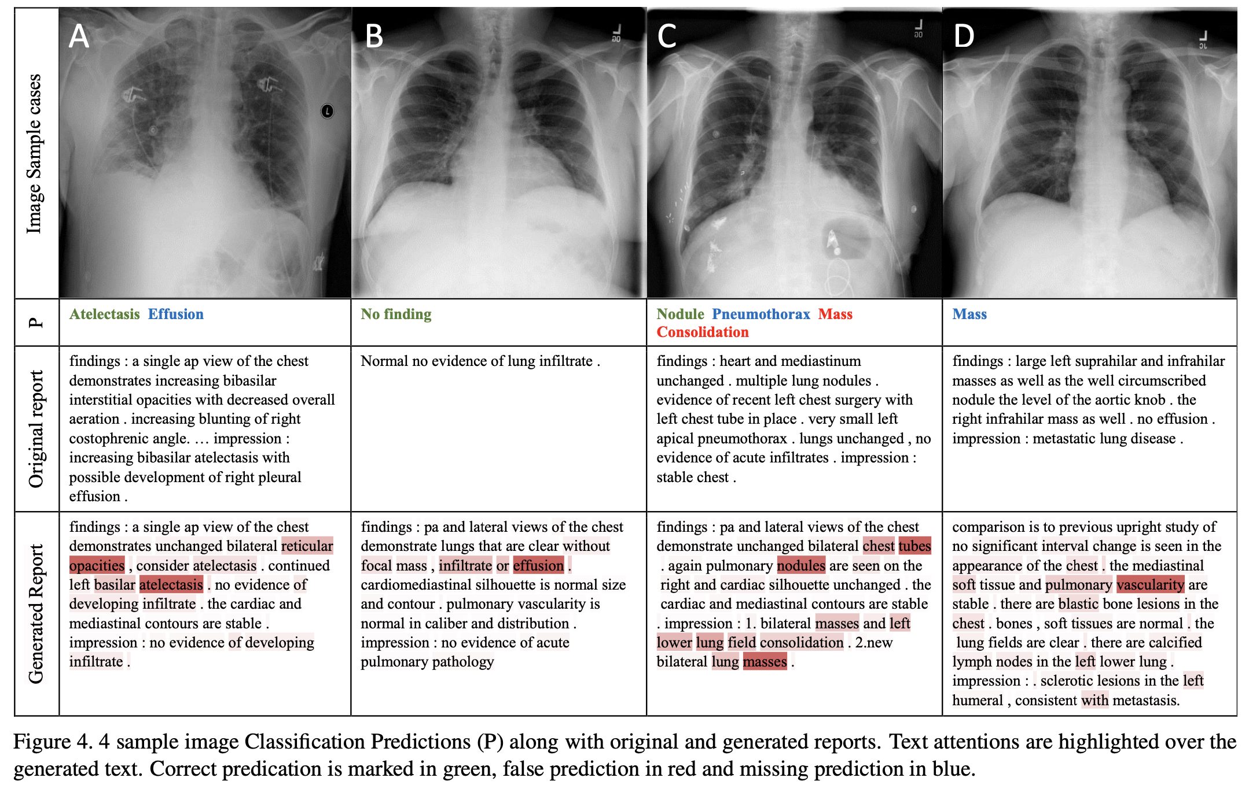

Slide 15
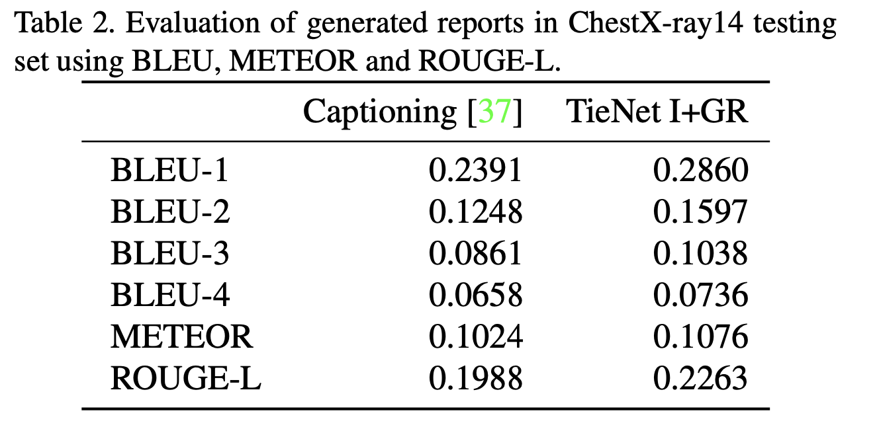

Slide 16
Causal Attention for Visual-Language Task
视觉语言人物的因果关系
Xu Yang¹, Hanwang Zhang¹, Guojun Qi², Jianfei Cai³ ¹School of Computer Science and Engineering, Nanyang Technological University, Singapore, ²Futurewei Technologies ³Faculty of Information Technology, Monash University, Australia,

Slide 17
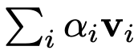
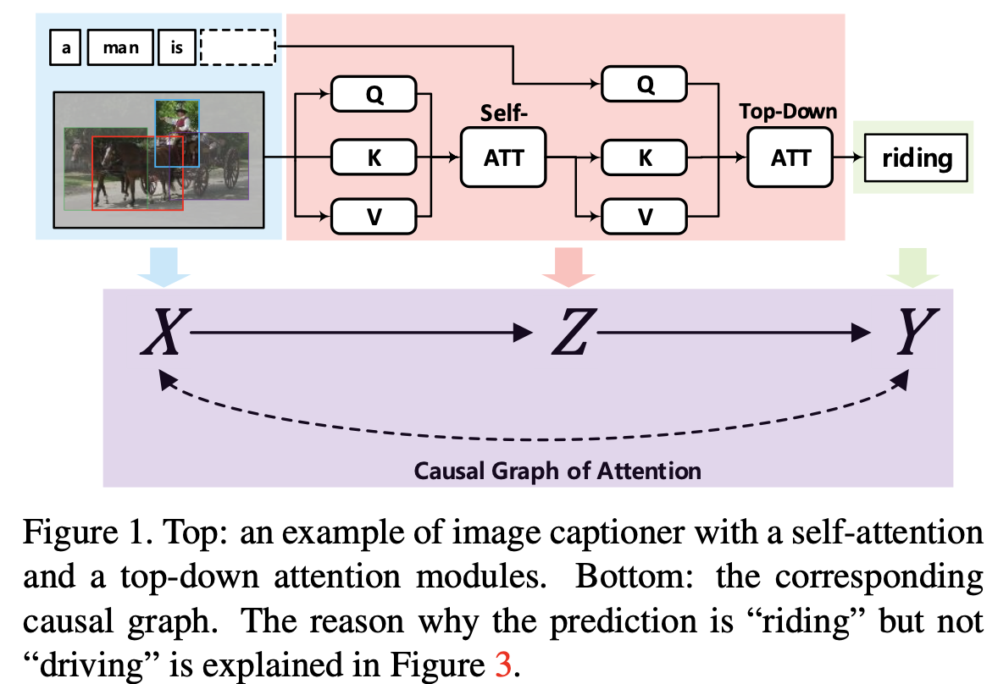
Introduction
Attention’s nature can be summarized as the following common Q-K-V notation
given a query q,the attention mechanism associates q to each feature value v_{i} by using
the normalized attentive weight α_{i} ∝ q^{T} k_{i}, where k_{i} is the key function of the value;thus,
the resultant selective feature value — attention — is.
-if q and V are both encoded from the input X, e.g., the RoI features of an image, we
call it self-attention; if q is changed to the sentence context, we call it top-down attention.
-self-attention is usually viewed as a non- local convolution network that enriches each local
value with global relationship features; top down- attention is used to enrich the context with the cross-domain relationship features.
-Both of them can be combined and stacked into deep networks, serving as powerful multi-modal encoder-decoder transformer networks

Slide 18
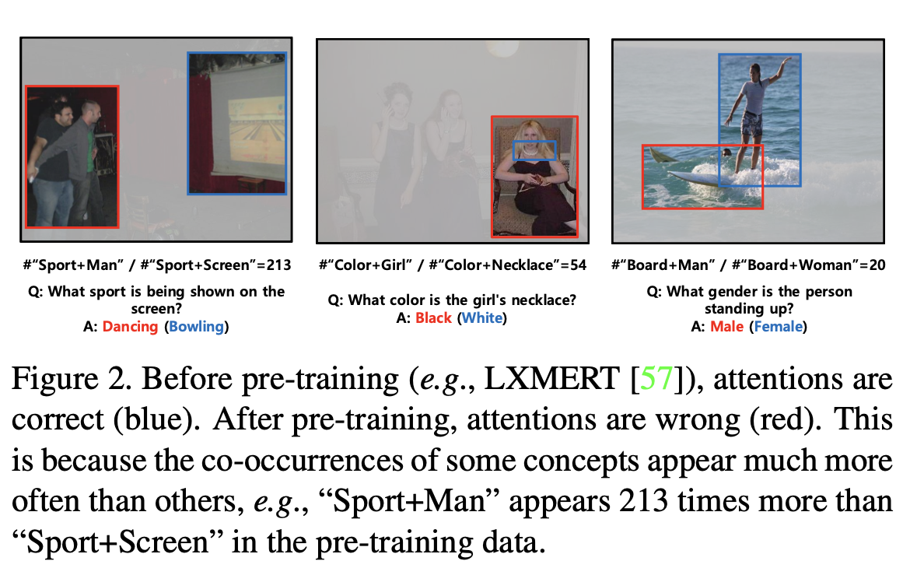
As a bridge connecting the input feature X and the output label Y , the quality of attention — how reasonable the attentive weight α is — plays a crucial role for the overall performance.
-However, due to the fact that the attention weights are unsupervised, the weights will be inevitably misled by the dataset bias.

Slide 19
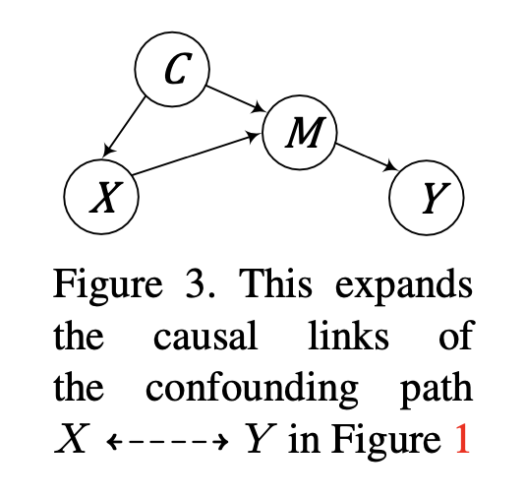
The dataset bias is essentially caused by the confounder, a common cause that makes X and Y correlated evenif X and Y have no direct causation.
-Suppose that the confounder C is the common sense “person can ride horse”, C → X denotes that a visual scene is generated by such knowledge, e.g., the dataset curator observes and cap- tures the common sense; X → M denotes the fact that the objects M = {person,horse} can be detected, whose object inventory is determined by C → M; M → Y denotes the language generation for “person riding horse”. Note that besides the legitimate causal path from image X via object M to Y , the “back- door” path X ← C → M → Y also contributes an effect to Y .
In this paper, we propose a novel attention mechanism called: Causal Attention (CATT), which can help the mod- els identify the causal effect between X and Y , and thus mitigates the bias caused by confounders.
-It is based on the front-door adjustment principle that does not require the assumption of any observed confounder.
-In this way, CATT is fundamentally different from existing deconfounding methods based on the backdoor adjust-ment, which has to be domain-specific to comply with the observed-confounder assumption.

Slide 20
Related Work
Attention Mechanism.
-Conventional top-down attentions generally include the classic single-guidance fashion and the co-guidance fashion. They can be summarized as the query, key, value (Q-K-V) operation.
We exploit the causal inference to propose a novel CATT module to mitigate the confounding effect.
Vision-Language Pre-Training.
-Researchers have developed some multi-modal Transformer- based Vision-Language Pre-training (VLP) models to learn task-agnostic visiolinguistic representations .However, just as the language pre-training models tend to learn or even amplify the dataset bias, these VLP models may also overplay the spurious correlation. We use the proposed CATT to help VLP models confront the bias.
Causal Inference.
-Causality provides researchers new methodologies to design robust measurements, discover hidden causal structures, generate counteractual samples, and confront various biases.
To tackle the sampling challenge in the front-door adjustment, we propose two effective approximations called In-Sample Sampling and Cross-Sample Sampling.

Slide 21
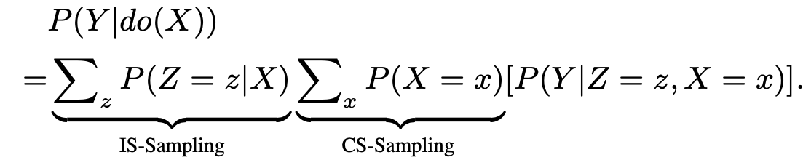
Model
Attention in the Front-Door Causal Graph
-we can split the attention mechanism into two parts: a selector which selects suitable knowledge Z from X and a predictor which exploits Z to predict Y .
-We can cut off the link X → Z to block this backdoor path by stratifying the input variable X into different cases {x} and then measuring the average causal effects of Z on Y。
-CS-Sampling alleviates such spurious correlation by combining the person region with the other objects from other samples, e.g., bike, mirror, or brush, and inputting the combinations to the predictor. Then the predictor will not always see “man-with- snowboard” but see “man” with the other distinctive objects and thus it will be forced to infer the word “man” from the person region.
-This is also called the front-door adjustment, which is a fundamental causal inference technique for deconfounding the unobserved confounder

Slide 22
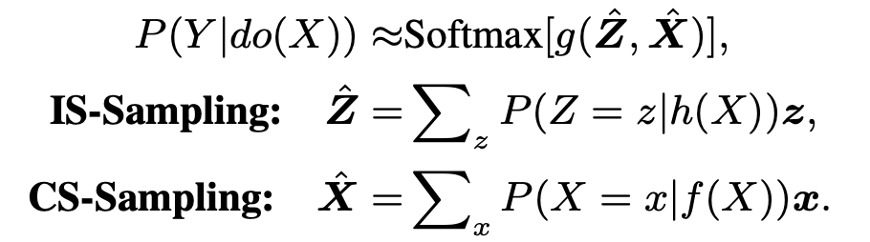
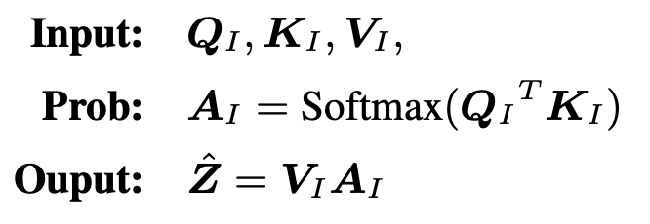
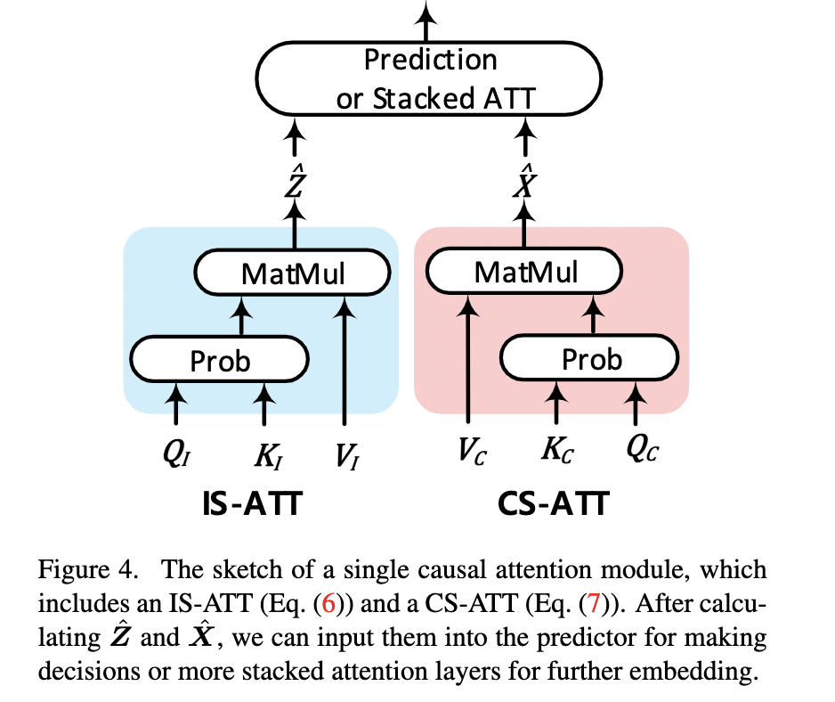
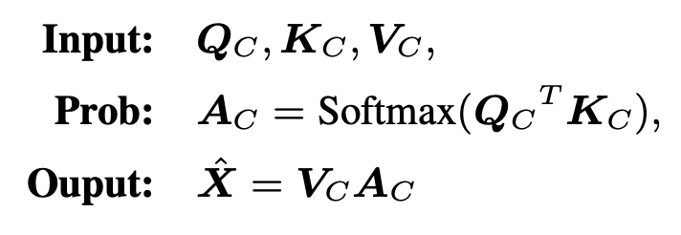
In-Sample and Cross-Sample Attentions
-To address this challenge, we apply Normalized Weighted Geometric Mean (NWGM) approximation [66, 54] to absorb the outer sampling into the feature level and thus only need to forward the “absorbed input” in the network for once。
where h(·) and f(·) denote query embedding functions which can transform the input X into two query sets.
-we set KC and VC as the global dictionaries compressed from the whole training dataset since it is impossible to attend to all the samples in the training set. Specifically, we initialize this dictionary by using K-means over all the samples’ embeddings in training set.

Slide 23
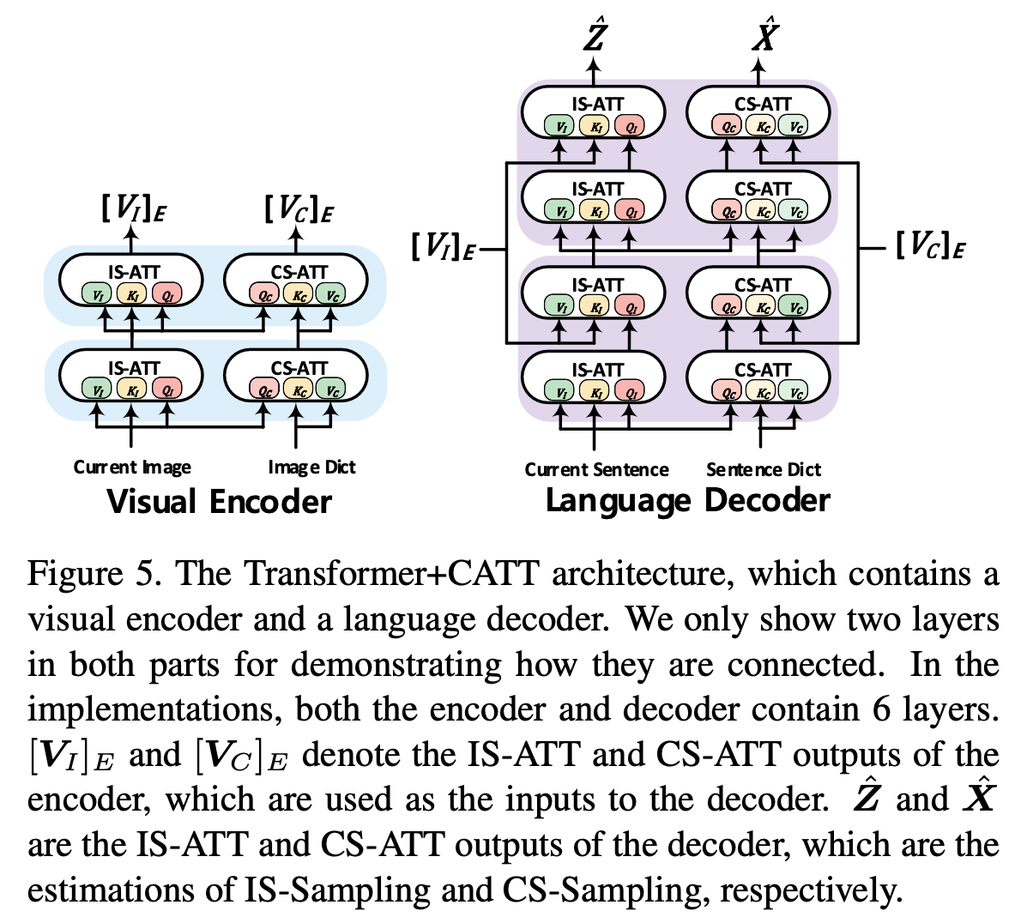
CATT in Stacked Attention Networks
In practice, attention modules can be stacked as deep networks, e.g., the classic Transformer or BERT architectures.
Transformer+CATT :

Slide 24
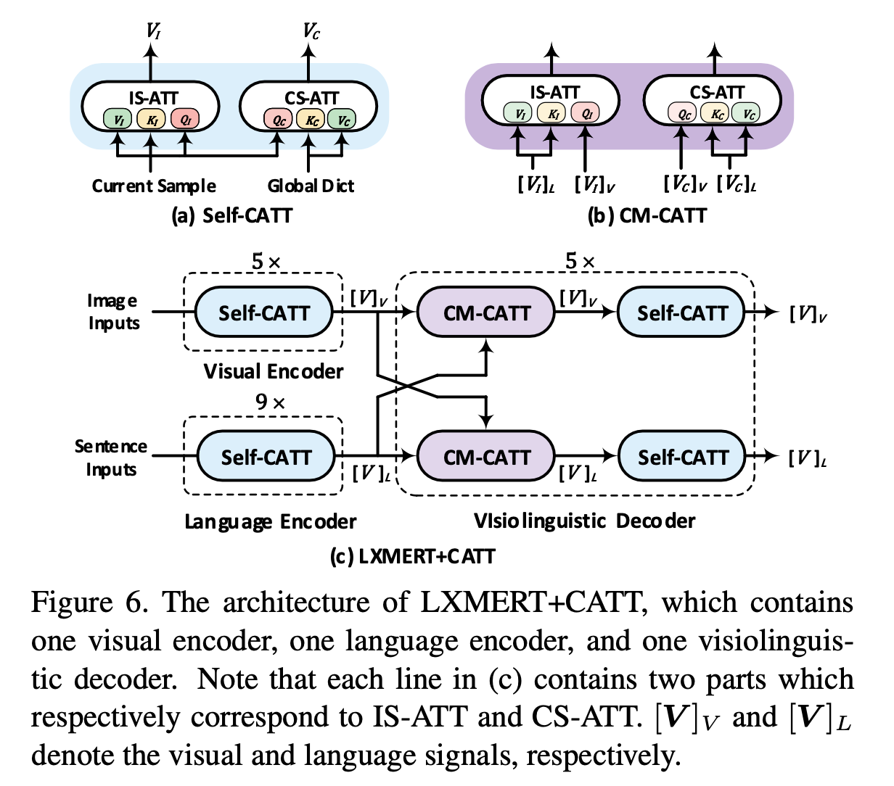
LXMERT+CATT
we share the parameters of IS-ATT and CS-ATT in each causal attention module to force their outputs to have the same dis- tributions.

Slide 25
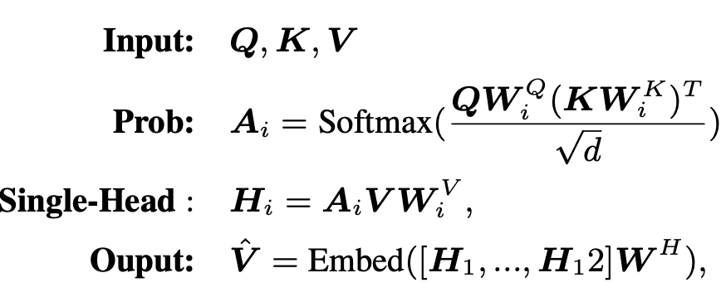
Experiment
Datasets
-MS COCO
-VQA2.0
-GQA
-Visual Genome
Implementation Details
where W_{i}∗ and W ^{H} are all trainable matrices; A_{i} is the soft attention matrix for the i-th head; [·] denotes the concatenation operation, and Embed(·) means the feed-forward network. The hidden size was set to 768. Importantly, we shared the parameters between IS-ATT and CS-ATT in each CATT to make the outputs stay in the same representation space. In this case, we also applied K-means to get the initializations and set the size of both dictionaries to 500.

Slide 26
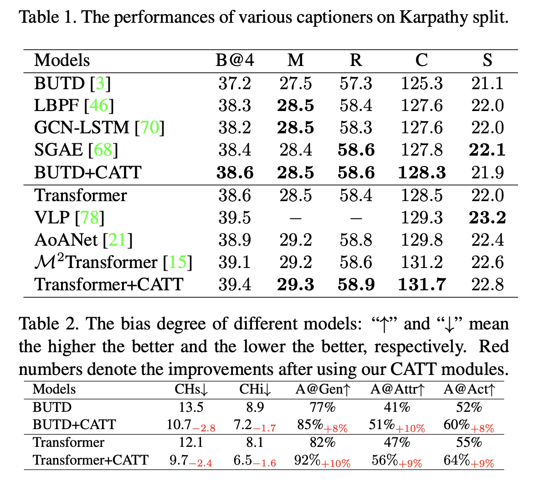

Slide 27
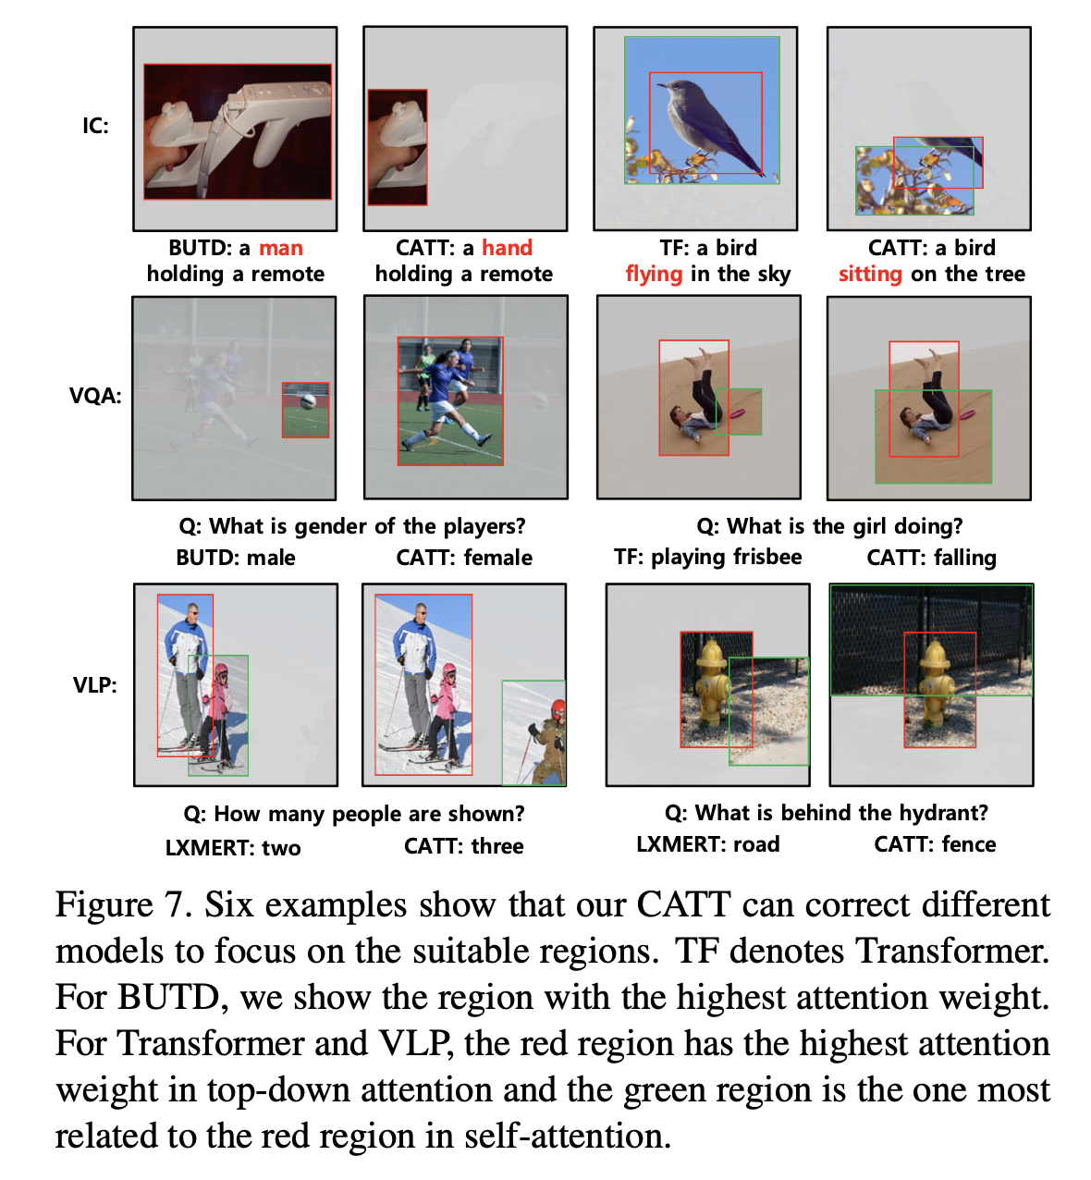
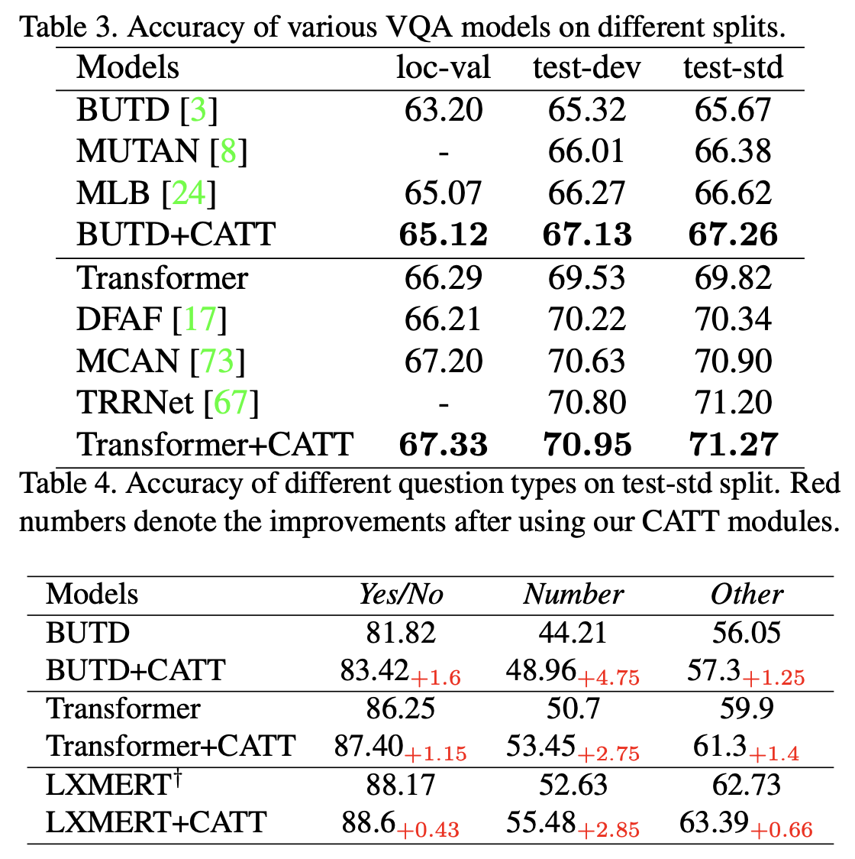

Slide 28
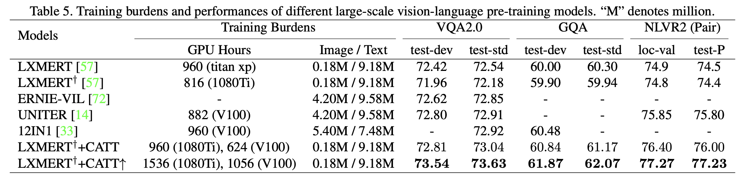

Slide 29
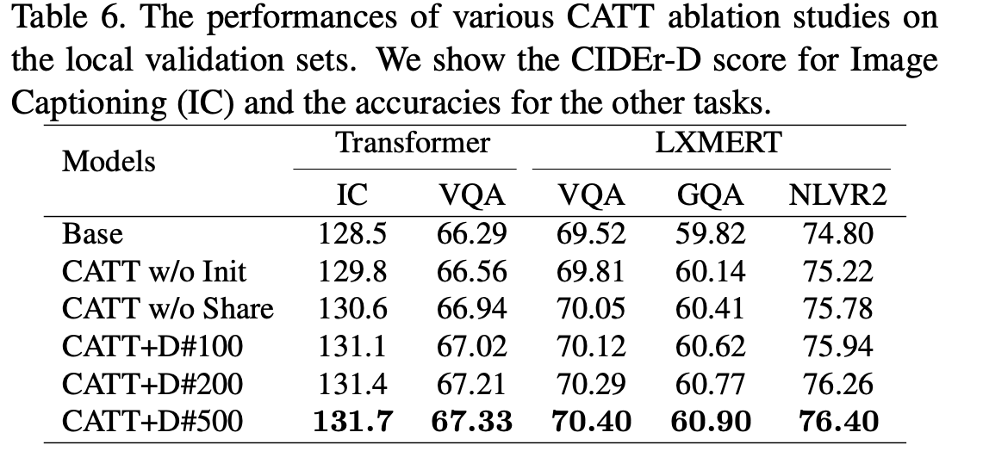
Ablation Studies
We carried exhaustive ablation studies to validate three variants of our causal attention module:
-K-means initialization
-dictionary size
-parameter sharing.
CATT w/o Init: We did not use the K-means algorithm to initialize the global dictionaries but randomly initialized them. We shared the parameters between IS-ATT and CS-ATT.
CATT w/o Share: We did not share the parameters between IS- ATT and CS-ATT. Here we used the K-means algorithm to initialize the dictionaries.
CATT+D#K: We set the size of the global image and word embedding dictionaries to K by the K-means algorithm and shared the parameters between IS-ATT and CS-ATT.

